Slide 1



SyncBoard - Revolutionizing Online Lectures and Collaboration
Group Members :
Roll No | Name | Email ID | Mobile Number
22108B0021 | Hansraj N Kshirsagar | hansraj.kshirsagar@vit.edu.in | 9892963066
22108B0029 | Utkarsh Karmungikar | utkarsh.karmungikar@vit.edu.in | 9867063183
22108B0041 | Shravani Nage | shravani.nage@vit.edu.in | 9167223637
22108B0054 | Harsh Jain | harsh.jain2254@vit.edu.in | 9820083781
Under the Guidance of :
Prof. Pranita Padhye

Slide 2



Introduction
SyncBoard is a concept designed to address the challenges of online lectures by providing an immersive virtual platform. It offers a 2.5D environment that integrates attendance tracking, focus analytics, real-time question submission, and live video streaming to simplify teaching and enhance student engagement.
• Online education has seen rapid adoption but suffers from engagement and interaction challenges.
•SyncBoard aims to bridge the gap between passive learning and active participation.
•Designed for both educational institutions and corporate environments.
Department of Electronics & Computer Science
2

Slide 3

Industry Expert with whom Project proposal is discussed
Name: Arnav Sonawane
Designation: Researcher at MIT
Department of Electronics & Computer Science
3

Slide 4

Review of Literature
Framework for Virtual Campus Tours (IEEE Xplore):
• This framework emphasizes creating immersive virtual tours for educational institutions to showcase their campuses remotely.
• It highlights the importance of user-friendly navigation, interactive elements, and realistic simulations to improve user experience.
_____________________________________________________________________________________________________________________
Flash-Based Virtual Campus System (IEEE Xplore):
• A system developed using Flash software demonstrated how even simple tools could create effective virtual campuses.
• However, limitations in scalability and interactivity highlighted the need for advanced platforms like Unreal Engine.
_____________________________________________________________________________________________________________________
Implications for SyncBoard:
• SyncBoard can leverage these frameworks to design intuitive navigation systems and realistic environments using modern tools like Unreal Engine.
• Incorporating immersive features such as campus tours or gamified exploration can enhance engagement.
Department of Electronics & Computer Science
4

Slide 5

Usefulness of the Project
SyncBoard provides solutions tailored to address key pain points in online education:
For Professors: Simplifies multitasking by automating attendance tracking, focus analytics, and question management
For Students: Improves engagement through interactive virtual environments.
For Institutions: Offers actionable insights into student performance, enabling better decision-making.
• Encourages accountability among students by linking attendance duration with performance metrics.
• Reduces technical barriers by integrating all features into one platform.
Department of Electronics & Computer Science
5

Slide 6

Social impact of the Project
SyncBoard has far-reaching social benefits:
Promotes inclusivity by enabling remote students to actively participate in lectures.
Builds stronger educational communities by fostering collaboration between students and professors.
Encourages accountability and discipline among students through focus tracking and performance-based grading.
Helps bridge the digital divide by providing an accessible platform for hybrid learning models.
Empowers educators with tools to deliver impactful lessons without added stress.
Department of Electronics & Computer Science
6

Slide 7

Objectives defined for the project
Create an immersive virtual campus environment using Unreal Engine (2.5D).
Automate attendance tracking with notifications sent to smartboards for real-time monitoring.
Integrate real-time question submission systems linked to smartboards for efficient feedback management.
Develop focus analytics to monitor student engagement during lectures and adjust grades accordingly.
Expand functionality to corporate environments for remote team collaboration.
Introduce gamification elements like badges, leaderboards, and rewards
Department of Electronics & Computer Science
7

Slide 8

Resources Needed (Hardware and Software)
Hardware Needed:
1. Raspberry Pi with camera module for live video streaming.
2. Smartboard or large display screen for notifications and analytics.
3. Server setup (cloud-based or local) for backend processing.
Software Needed:
1. Unreal Engine for creating the virtual environment.
2. WebRTC for video integration from Raspberry Pi cameras.
3. Backend server (Node.js/Flask) for data handling and analytics.
Department of Electronics & Computer Science
8

Slide 9

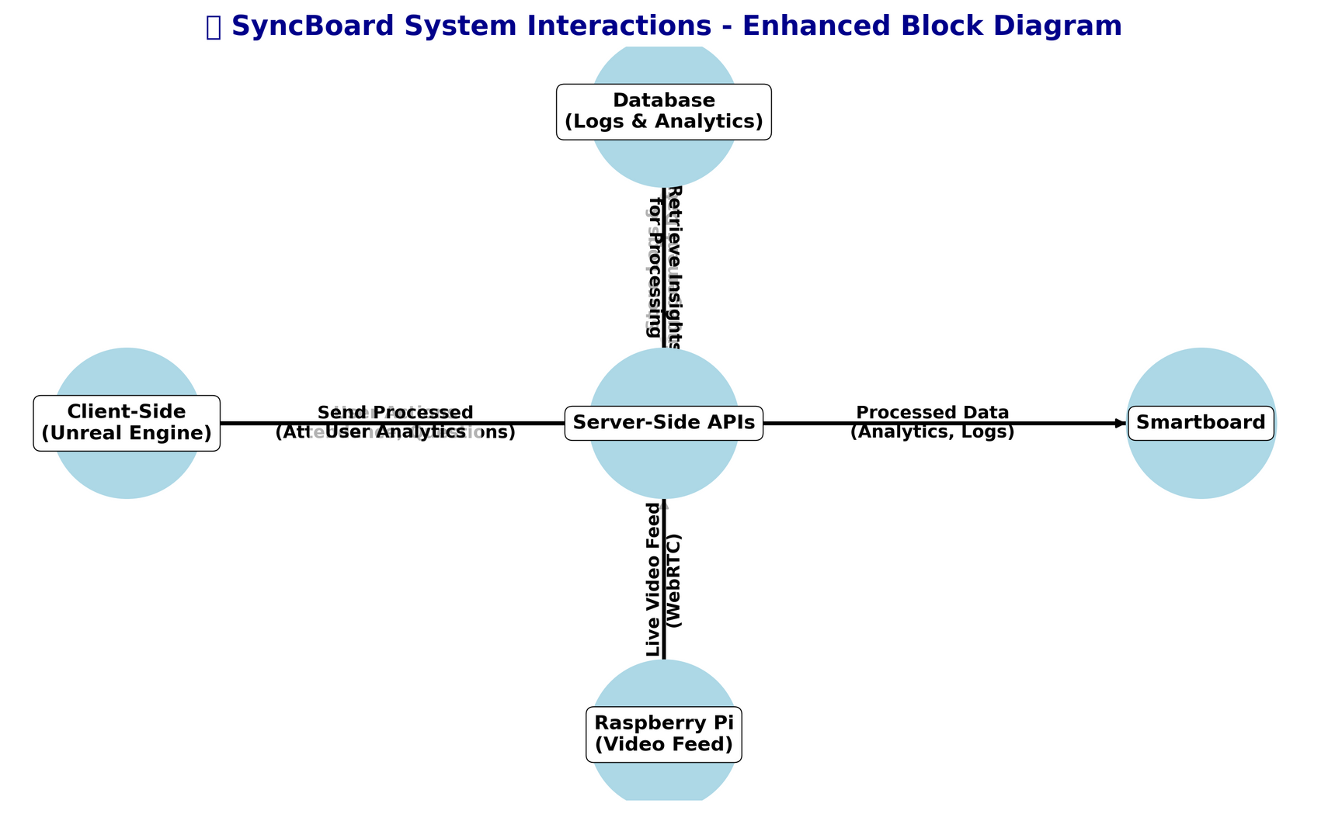
Block Diagram
Department of Electronics & Computer Science
16

Slide 10

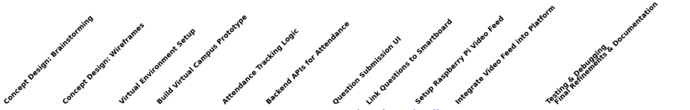
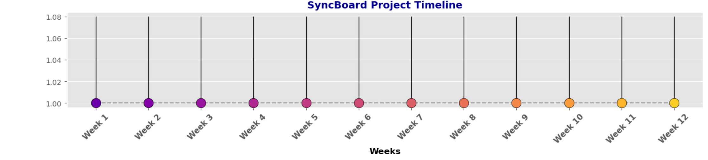
Project activities planned with a timeline
Department of Electronics & Computer Science
11

Slide 11

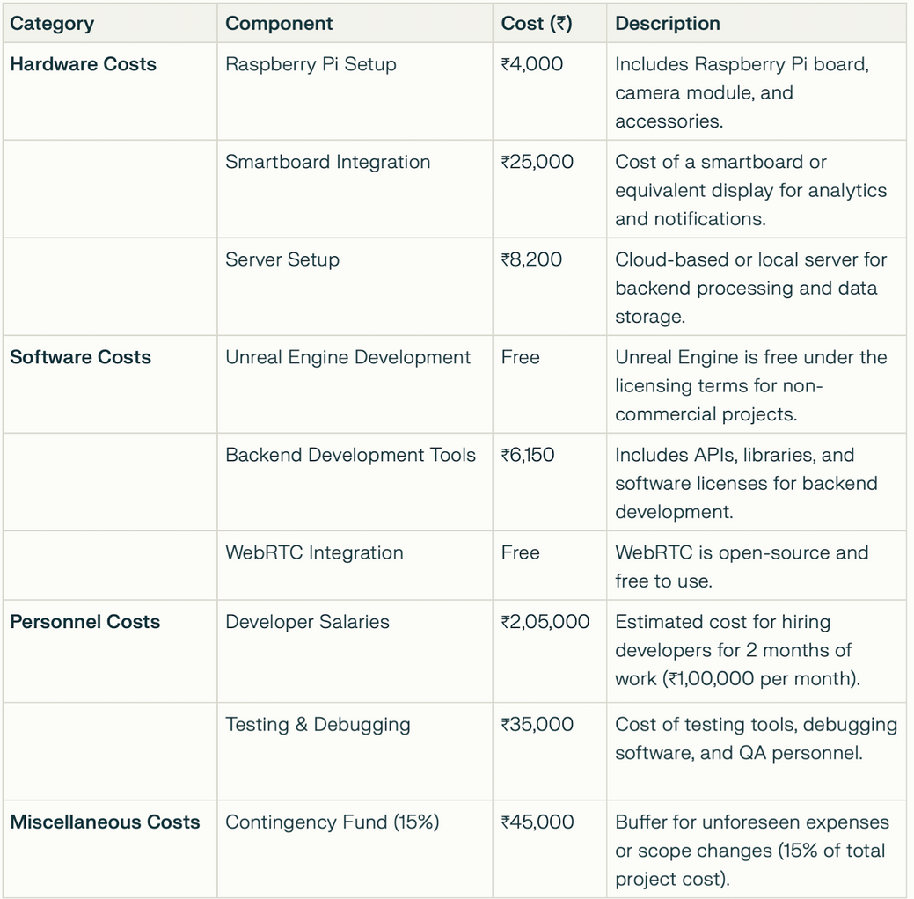
Project Cost
Department of Electronics & Computer Science
14

Slide 12

Methodology
SyncBoard integrates a 2.5D virtual environment with the core features of traditional collaboration tools to deliver an immersive and secure experience. Teachers begin by using a capture app on the smartboard to input a unique code specific to the class, division, and year—ensuring that only students who are part of the designated classteam can join the lecture.
When a student navigates into the virtual class, they immediately receive a live feed of the smartboard content on their main screen, along with a small window that streams real-time video of the professor’s movements. Additionally, students can ask questions via a chatbox, which appears as a popup on the smartboard for prompt teacher attention. Attendance is dynamically tracked based on each student's presence and engagement, with periodic checks enforcing active participation. Moreover, if a student is inactive for multiple days, the professor can revoke their online access, compelling the student to join the lecture in offline mode.
Department of Electronics & Computer Science
15

Slide 13
Conclusion
📌
SyncBoard addresses key challenges in online education by offering an innovative platform that enhances engagement, simplifies teaching processes, and provides actionable insights into student performance.
This expanded content ensures your presentation is detailed yet easy to follow while showcasing SyncBoard’s potential as a revolutionary concept! Let me know if you need help sourcing specific images or diagrams!
Department of Electronics & Computer Science
19

Slide 14
References
📖
1. Albrektsen, S. M., & Johansen, T. A. (n.d.). SyncBoard - a High Accuracy Sensor Timing Board for UAV Payloads. Retrieved from https://torarnj.folk.ntnu.no/0154.pdf
2. GitHub repository: Rohan-Shakya/SyncBoard. (n.d.). Retrieved from https://github.com/Rohan-Shakya/SyncBoard
3. GitHub repository: naumanch969/syncboard. (2024). Retrieved from https://github.com/naumanch969/syncboard/
4. Huck, T., & Westenberger, A. (2011). Precise timestamping and temporal synchronization in multi-sensor fusion. Retrieved from https://www.semanticscholar.org/paper/Precise-timestamping-and-temporal-synchronization-Huck-Westenberger/33584d4c08005329e98e4a3e900d816aa46488f1
5. MaximilianHeidenreich/SyncBoard. (n.d.). Retrieved from https://sveltethemes.dev/MaximilianHeidenreich/SyncBoard
6. SyncBoard project on Devpost. (n.d.). Retrieved from https://devpost.com/software/syncboard
Department of Electronics & Computer Science
20

Slide 15


THANKS!
21
Department of Electronics & Computer Science

